Slide 1


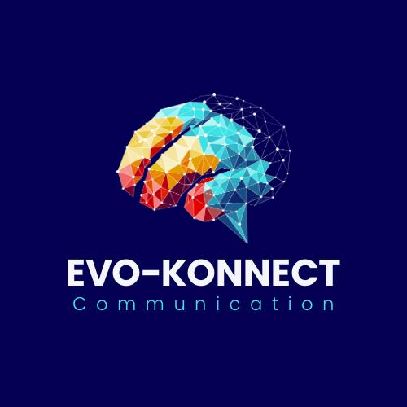
EVO-KONNECT
MOBILE WALLET
Group 4: Evo-Konnect Communication
Professor: Elsie Umukoro
Date: 13/12/2024
Team Members: FAVOUR UKAEGBU – 8928897 ASHIYANA MUSTAK, PATEL – 8638163
SANDRA OKOYE - 8730251 HET, MODI - 8911357 VRISHIN, PATEL- 8865131 ASHISH MANU, MANI – 8930100

Slide 2

OUR TEAM
Favour
Ukaegbu
Ashiyana Patel
Sandra
Okoye
Het
Modi
Vrishin Patel
Ashish Manu
Project
Manager
Business
Analyst
Marketing
Specialist
Financial
Analyst
Data
Analyst
Software
Developer

Slide 3

AGENDA
Executive Summary
About the Project
Project Charter
Business Opportunity
SWOT Analysis
User Stories/Acceptance Criteria
Current “As-Is” Process
Dashboard
Project Timeline
Cost-Benefit Analysis and ROI
Challenges Faced
Implementation Strategies
Database and Process Design
Solution Evaluation and Recommendation
Transition Requirements and Next Steps
Conclusion

Slide 4
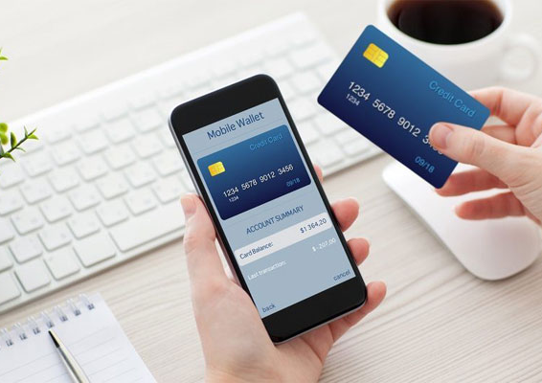
EXECUTIVE SUMMARY
Evo-Konnect seeks to integrate a mobile wallet into its existing services to enhance customer engagement, retention, and revenue generation. The mobile wallet will allow seamless, secure transactions, providing a superior user experience. This aligns with Evo-Konnect's strategic goal to lead in digital services.
This Photo by Unknown Author is licensed under CC BY

Slide 5



ABOUT THE PROJECT
Project Scope:
Develop a secure and scalable mobile wallet
Integrate with existing Evo-Konnect services
Launch on iOS and Android platforms
Key Deliverables:
Functional mobile wallet
Full testing and deployment strategy
Constraints: Time (6 months), Budget ($500,000)

Slide 6

PROJECT CHARTER
Project Title: Evo-Konnect Mobile Wallet Development
Prepared By: Favour, Ashiyana, Het, Vrishin, Sandra, Ashish
Project Justification:
To enhance customer convenience, boost transaction efficiency, and improve user retention through a secure, scalable mobile wallet solution.
Success Criteria:
10,000 new users in the first 3 months.
90% customer satisfaction rate based on feedback surveys.
Secure, bug-free deployment within 6 months.

Slide 7

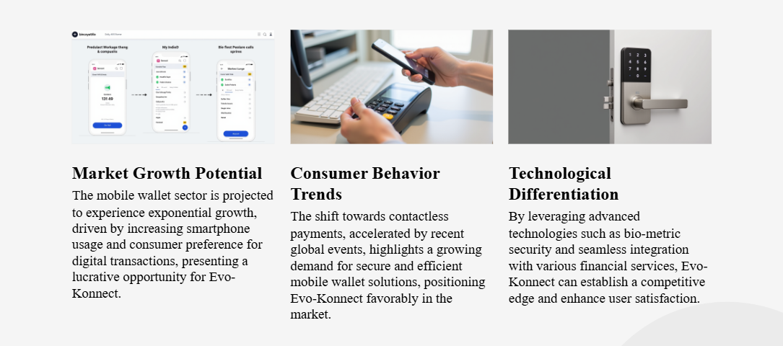
THE BUSINESS OPPORTUNITY

Slide 8
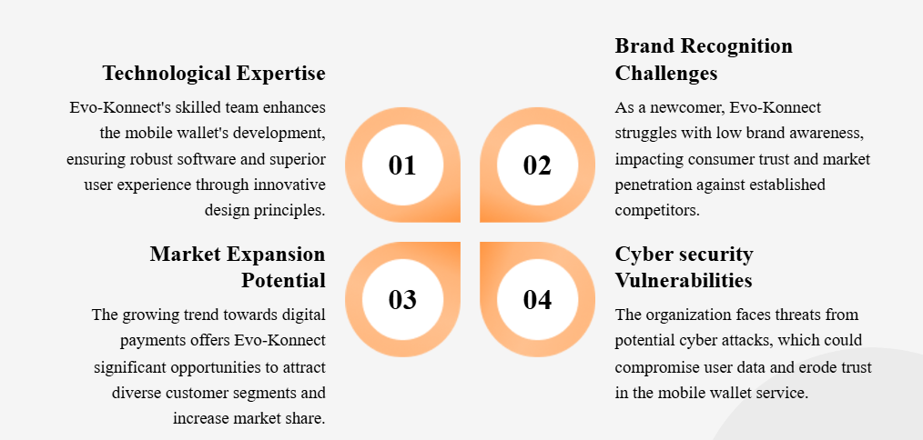
SWOT ANALYSIS

Slide 9
USER STORY: ENHANCING CUSTOMER EXPERIENCE
As a new user, I want to easily set up an account and securely link my bank or credit card so I can start using the mobile wallet quickly.
As an existing user, I want to access my wallet with my current login credentials and save my payment details for future transactions without re-entering information.
As a loyal customer, I want to earn reward points for every transaction and redeem them for discounts or exclusive offers.
As a mobile wallet user, I want to complete transactions in just a few taps to save time and effort.

Slide 10
ACEPTANCE CRITERIA
User Registration:
New users can sign up using their email and phone number.
Users must securely link a bank account or card to access wallet features
Usability:
The interface allows transactions in 3 simple taps.
A help section is available for troubleshooting.
Transaction Capabilities:
Transactions must complete within 2 seconds.
Users receive an email and in-app receipt for every transaction
Loyalty Program:
Users earn reward points per transaction.
Real-time reward balance is displayed in the app

Slide 11
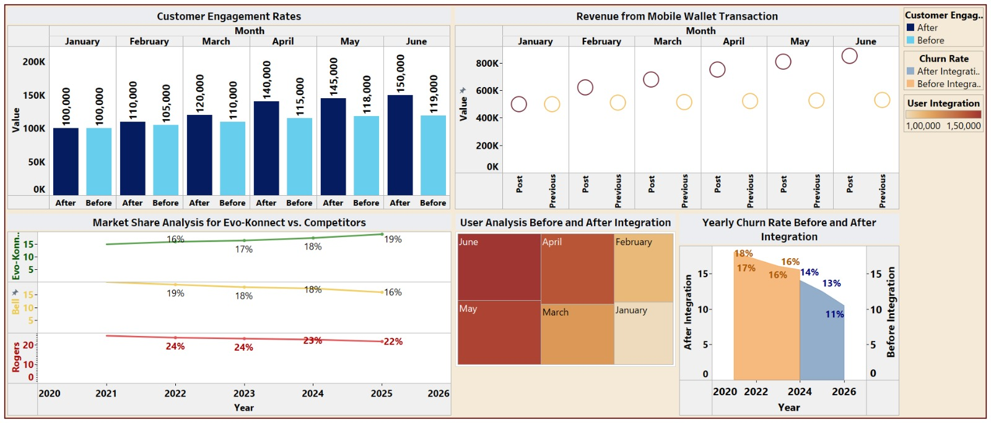
PROJECT DASHBOARD

Slide 12
PROJECT TIMELINE

Slide 13


01
02
03
04
05
JANUARY
FEBRUARY
MARCH
APRIL
MAY
Kick-off meeting
Role assignments Requirements gathering
"As-Is" process mapping.
Evaluate solution options
Conduct feasibility studies
Draft report
Complete ROI analysis
Develop implementation and testing strategies
Select tools.
Document final details
Review with client
Incorporate feedback
Deliver final recommendations
Demo the solution
Obtain approval

Slide 14





COST BENEFIT ANALYSIS AND ROI
Costs
Benefits
ROI
Development ($250,000)
Testing ($100,000)
Marketing ($50,000)
Maintenance ($100,000)
Increased user engagement
Revenue through transaction fees
Reduced churn
120% over 3 years

Slide 15
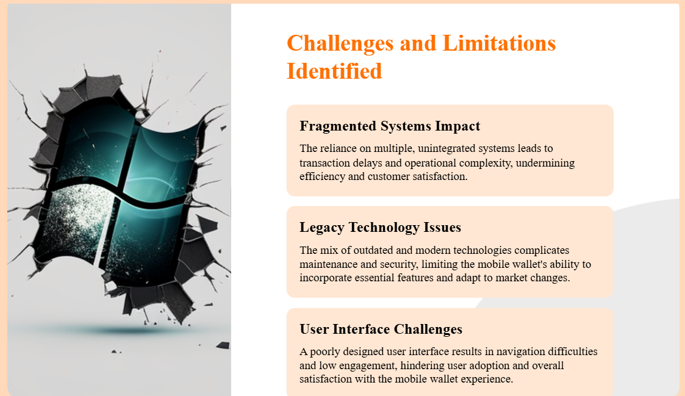
CHALLENGES

Slide 16


CURRENT “AS-IS” PROCESS
Current State
Manual payment methods
Limited integration with mobile platforms
Lacking features like bill splitting and transaction history
Challenges Identifies
Inefficient user experience
Security vulnerabilities

Slide 17

IMPLEMENTATION STRATEGY
Beta release for select users
Gradual rollout to all users
Development
Testing
Deployment
Create user guides and offer 24/7 support during launch
Phased Rollout
Key Milestones
Training and Support

Slide 18
DATABASE AND TO-BE PROCESS DESIGN
Database Design
To-Be Process
User Profiles Table: User ID, Name, Email, Phone
Transaction Table: Transaction ID, Amount, Date, Status
Security Table: Encrypted Keys, Tokens
Simplified and automated user flows for transactions
Real-time updates and notifications

Slide 19


TRANSITION REQUIREMENTS
Technical Requirements: Server upgrades, third-party API integration
Organizational Requirements: Staff training, user communication
Data Migration: Secure transfer of user data to the wallet system

Slide 20
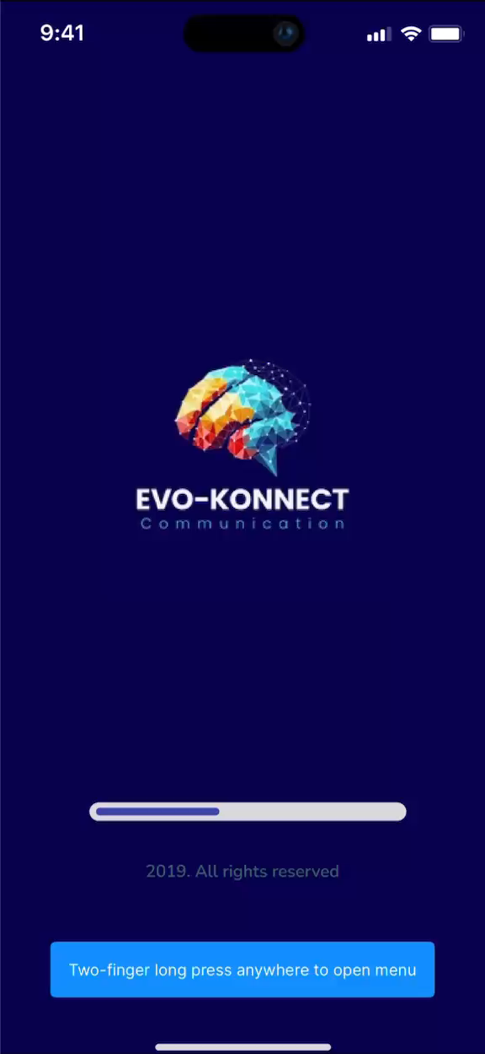
APPLICATION
DESIGN

Slide 21



TEST STRATEGIES
TESTING PHASE
TOOLS USED
EXIT CRITERIA
Unit Testing
Integration Testing
System Testing
User Acceptance Testing
Selenium
JIRA
Postman
Appium
All critical and high-priority issues resolved

Slide 22
RECOMMENDED SOLUTION
Key Features
Contactless Payments: Tap-to-pay functionality for faster transactions.
In-App Transactions: Pay bills, transfer funds, peer-to-peer, and recharge directly within the app.
Loyalty Program Integration: Users can earn, track, and redeem loyalty points directly within the wallet.
Why This Solution?
Customer Demand: Aligns with increasing preference for digital wallets.
Revenue Growth: Monetize through transaction fees and partnership opportunities.
Competitive Edge: Differentiates Evo-Konnect from competitors in the market.

Slide 23
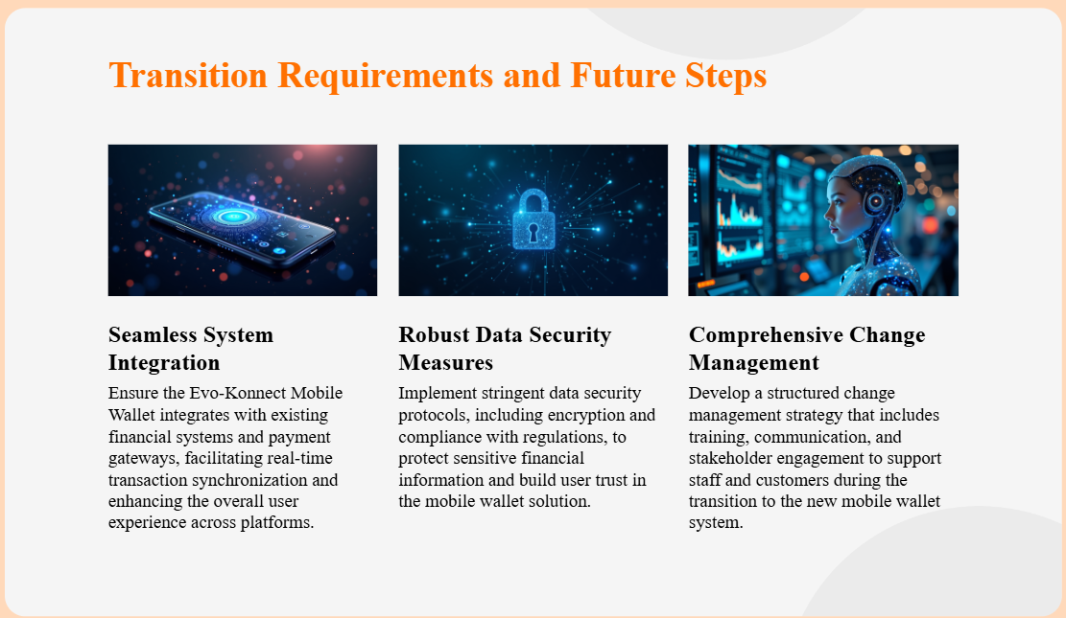
TRANSITION AND FUTURE STEPS

Slide 24
CONCLUSION
Innovative Solution
Training and Support
Key Milestones
Mobile Wallet integration offers secure, seamless, and user-friendly functionality.
Comprehensive user tutorials, staff training, and a 24/7 helpdesk ensure smooth adoption and usage of the wallet.
Each milestone ensured progress was measured, risks were managed, and deliverables were aligned with objectives.

